Slide 1
Writing for Meaning and Metacognition: Implementing Math Journals in a 5th Grade Classroom
Nina Marie Miller

Slide 2
Introduction
PROBLEM OF PRACTICE: Students talk more about Math, but struggle with sharing their explanations and thoughts in writing.
TOPIC: daily student writing in a math journal to improve understanding of, communication about, and confidence in Number Sense and Multiplicative Reasoning
PERSONAL IMPORTANCE: I want my students to be able to clearly communicate mathematically.
EDUCATIONAL/MATHEMATICAL IMPORTANCE: Communication is an essential mathematical process; teachers need practical journal strategies for students

Slide 3
Literature Review
NCTM explains in their Principles and Standards for School Mathematics (2000) that “schools need elementary teachers who are more proficient in orchestrating classroom discourse in ways that promote the investigation and growth of mathematical ideas…Communication is an essential math process standard for all grade levels…reflection and communication are intertwined processes in mathematics learning…written communication should be nurtured.” (pp. 61 & 62)
Writing for Mathematical Meaning
Writing for Mathematical Metacognition
Math Journal Implementation Strategies
In 2004 Marilyn Burns published “Writing in Math” in Educational Leadership, where she explained, “Writing in math class supports learning because it requires students to organize, clarify, and reflect on their ideas—all useful processes for making sense of mathematics. In addition, when students write, their papers provide a window into their understandings, their misconceptions, and their feelings about the content they’re learning. (p. 30)
“Communication is an essential part of mathematics and mathematics education. It is a way of sharing ideas and clarifying understanding…The communication process also helps build meaning and permanence for ideas and makes them public. . . they communicate to learn mathematics and they learn to communicate mathematically.” (NCTM, 2000, p. 60)
Baxter, Woodward, and Olson (2005) looked at weekly journals of low-achieving students in a seventh-grade general math class. The study revealed that despite being designated as years behind in math skills and lacking participation in class discussions, the writing of these students revealed deeper understanding. The authors summarized that “our analysis of the students’ journals identified multiple instances where the students were able to explain their mathematical reasoning, revealing their conceptual understanding, ability to explain, and skill at representing a problem.” (p. 119)
In William Zinsser’s book, Writing to Learn (1988), he states “Writing is a way to think yourself into a subject and make it your own.” (p.16).
Notes:
NCTM: “process…communicate to learn mathematics and learn to communicate mathematically”
Nat. Research Council (’01) - first 3 strands of proficiency, Meaning Making 3 strands: conceptual understanding, procedural fluency, strategic competence
Baxter, Woodward, Olsen (‘05) – reveals deeper understanding, examined weekly journals of 4 low-achieving students in 7th grade Math
Scott (‘07) - improved comprehension & higher-order thinking, 23 5/6 students in Australian classroom, extended writing at end of geometry lessons, improved meaning making for marginalized students
Bainbridge, Ellis, Wolodko (03) - conceptual understanding, 5 elementary classrooms over 13 years
Nat. Research Council (’01) - last 2 strands of proficiency, Metacognition, adaptive reasoning and productive disposition
Van de Stel, Veenman, Deelen, and Haenen (‘10) - metacognitive skills better predictor of success than IQ, 59 teenagers
McIntosh & Draper (‘01), Scott (‘07) - personal reflection, years of reflective learning logs in their classrooms; culturally diverse students willing to write more than discuss
Williams and Wynne (2000) - affective prompts in HS classes, for variety, allows students to express selves, affective views encourage teachers to examine their own practices/methods
Drake and Barlow (‘07) – student problem writing, multiplication understanding in 6th graders
Santa Cruz & Sanchez-Gutierez (2009) – vocab in sentences for ELL, 2x2 sentence builders
Williams & Wynne (2000) – closure, timing, rubric grading
Baxter, Woodward, Olsen (‘05) – expressive → expository prompts
Fried and Amit (2003) – privacy of student journaling

Slide 4
Research Questions
What happens when I include a more specific focus on writing during mathematics?
How can I effectively integrate math journals with the Number Sense and Multiplicative Reasoning portion of an investigation-based curriculum model?
How does journaling about mathematics experiences support students in describing their processes/strategies and in explaining their thinking?
How can the math journals support students’ metacognitive awareness?

Slide 5
Action Plan
Week 1: Pre-Survey, Pre-Assessment, Introduce journals, rubric, & expectations
Weeks 2 – 4: More Affective/Personal Daily/Weekly Journal Prompts
What is Math? Is Math important? Why or Why not?
Should kids be allowed to use calculators? Explain.
Tell me your thoughts about your thinking & learning.
Weeks 5 & 6: Near Daily Prompts, Quickwrites for opening/closure, some extended prompts, frequent sharing/discussion of journal writing
Choose one number puzzle you solved. Describe step-by-step how you solved it and why you solved it that way.
Find out about someone else’s strategy. Compare their strategy to yours and explain how it was the same/different.
Solve a problem and explain how/why...

Slide 6
Action Plan, continued
Weeks 7 – 11: More content-specific prompts
If I ordered 1,800 tiles, what dimensions of rectangular floors could I make? Are all of your listed dimensions realistic? Why or why not?
Write a story problem that represents 35x28. Solve the problem using words, pictures, and numbers. Then explain how your solution strategy relates to both the story context and the picture(s).
Which presentation made the most sense to you today? Why? How did you connect with that group’s strategy?
Why are there “rules” for what order we’re supposed to add/subtract, multiply/divide, etc.?
Should we explore/teach different strategies, or just do one way (the standard US algorithm). Explain as though you are trying to convince the Math leaders.
Week 12 – Post-Assessment, Post-Survey, Video Interviews, Collected All Journals for Final Analyses

Slide 7
Data Collection/Triangulation
Integrations with Number Sense/Multiplication Investigations
Pre/Post Assessments
Weekly Teacher Journal Entries
Student Work Samples from Journals/Assignments
Student Processes/Strategies, Explanations of Thinking
Pre/Post Assessments
Video clips of class time, video interviews of select students
Student Work Samples from Journals/Assignments
Metacognitive Awareness
Pre/Post Surveys
Weekly Teacher Journal Entries
Student Work Samples from Journals/Assignments

Slide 8
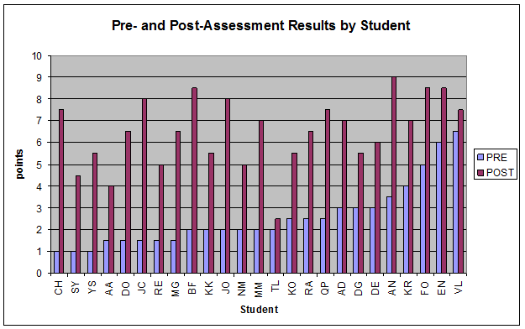
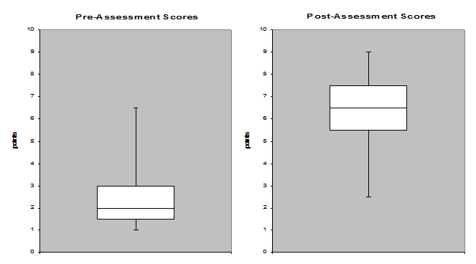
Assessment Score Findings
Notes:
Pre-Mean: 25% correct
Post-Mean: nearly 70%
Average increase of 4/10 points

Slide 9
Finding: Improved Test Explaining & Reasoning
Student Code from Table 1 | Item #. | Pre-Assessment Response | Post-Assessment Response
DG | 2 | < | 30 x 60 < 40 x 50 I know that 3 x 6 is 18 and there was two zero’s. I know that 4 x 5 is 20, and it equals more.
QP | 7 | There was 57 taxes. Each taxe hod up to 5 people in it. 18 taxes cam. 30 taxes got sike. 1 taxe less then 5 people in it. | there is 83 teams and 57 basketball players. How many basket ball players. 50 x 80 = 4,000 50 x 3 = 150 7 x 80 = 560 7 x 3 = 21 4000 + 560 + 150 + 21 = 4,731 There is 4,731 basket ball players.
NM | 7 | There are 57 monkeys on a tree. Then 83 came from the other tree how many are there. 57 X 83 = 5,641,521 | There was 57 boxes. There were 83 in each box. How many are there. [used array and picture to show work] 4,731
VL | 8 | 41, 82, 123, 164, 205 so 5 | 5 buses are needed. I know that 41x4=164 and if you add 41, you go over. So you use a 5th bus with a few spots left.

Slide 10
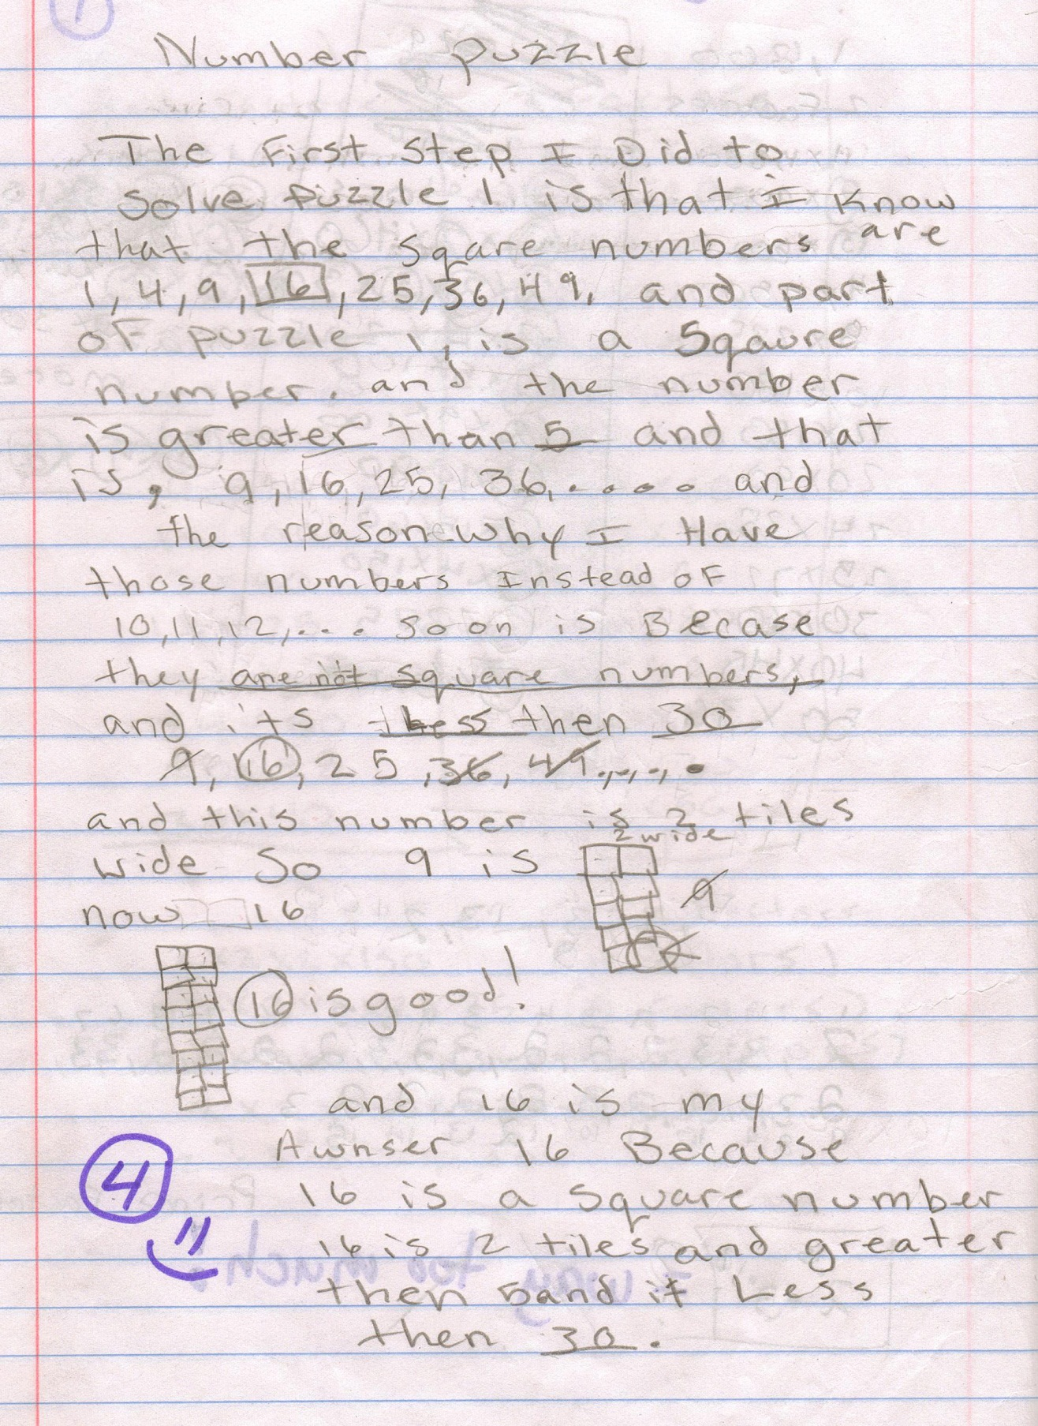
Finding: Writing Reveals More about Student Understanding & Reasoning
How are the factors of 36 related to the factors of 72?
Category | Quoted Student Writing
Times by 2 | You just times it by two Because if you take 36x2 you get 72 that is why the factors 36 and 72 related The factors of 36 and 72 are related because 72 is just 36 times 2 All the factors of 36 are factors of 72. All factors of 36 when multiplied by 2 also factors of 72 since 36 is half of 72.
Double | There related to each other because it has the same pattern but it is doubled They are related because you have to double it Double the second have of factor of 36 to get the factor of 72
36 is a factor of 72 | Because 36 is a factor of 72 so factors of 36 are factors of 72. They are related because 36 is a factor of 72. 36 and 72 are related because 36 is a factor of 72
Same | They relayted like this they have the same factors. They have the same pattern. They have the same numbers. 36 helps getting the factors of 72 becase you get the same numbers. Because they are some of the same factors
5th grade girl:
We figured out puzzle number 1 in our heads. These were the clues: This number is even. This number is a square. This number is a multiple of 9. This number has 2 digits.
I know that 6x6=36 is a square because it is 6 x’s itself (6²). 36 is even (6 is an even number), is a multiple of 9, (9x4=36), and has 2 digits (digit→36←digit).

Slide 11
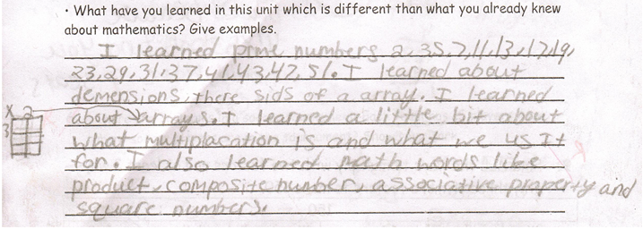
Finding: Thoughtful Student Writing About What They Learned
Assessment Question: What did you learn in this unit that is different than what you already knew about mathematics?
5th grade girl:
I learned how to divide while still multiplying. Like in #8, I couldn’t figure out how to solve it. I thought about it and came up with using multiples of 41 to get the answer. I realized that no multiple of 41 would equal 196. So, I needed it to be over 196 and when I got 205 I counted how many 41’s there were.
Assessment Question: What did you learn in this unit that is different than what you already knew about mathematics?
5th grade girl:
I didn’t know that you could do so many ways to do Math, and I learned that there is’t Just one way to get the right answer and you can check your answer Just to see if you correct and I have to do all of these amazing ways to do Math…now that I’m in this Math class I understand Math now and it’s kind of hard but not really any More and I learned that this unit is different than all of the other ones. [sic]
5th grade boy:
I was already good at Math But now I’m awesome. I have a bunch of stagerys. If I get confused on one stagery I can use others. [sic…followed this response with examples of multiplying 35x21 in two different ways]

Slide 12
Finding: Personal Prompts Allow Students to Connect More Deeply to Content
Asssessment Item 4, “Explain…why that strategy works.” Students explained why it worked for them rather than the mathematical reasons I had intended.
Students wrote more un-prompted metacognitive journal statements over time, especially after week three. Effective prompts helped students begin to naturally see the “why’s” and “how’s” of their own processes.
U.S. Algorithm prompt elicited strong reactions.
Boy: “I am only ok at U.S. standard algorithms because it confuses me as in I don’t know where to start off. But I am good at arrays, cluster problems, and breaking numbers apart. In all three they tell me where to start off…and afterwards I use an array to check my work. So the bottomline is multiplication is a strength for me with different ways.”
Notes:
Boy: “I am only ok at U.S. standard algorithms because it confuses me as in I don’t know where to start off. But I am good at arrays, cluster problems, and breaking numbers apart. In all three they tell me where to start off…and afterwards I use an array to check my work. So the bottomline is multiplication is a strength for me with different ways. “

Slide 13
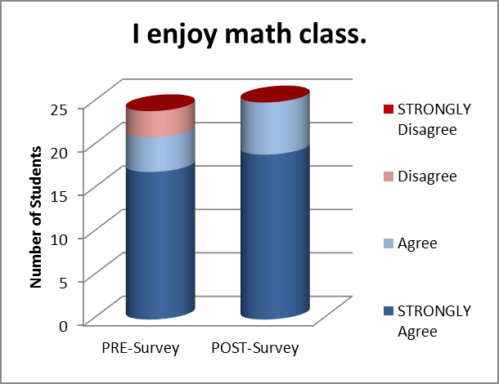
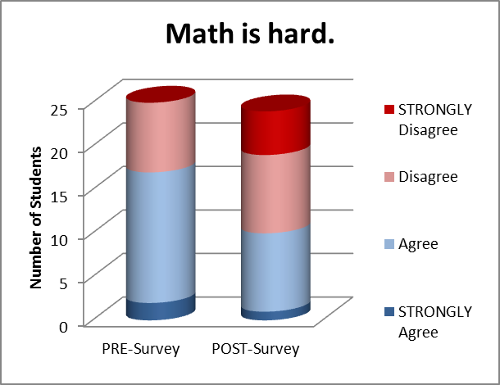
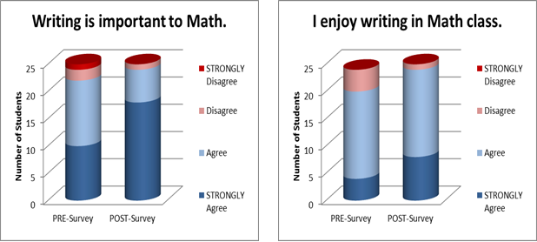
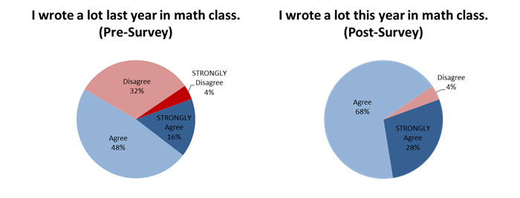
Survey Findings
“How has writing changed the way you learned Math?”
Pre-Survey: all students stated that either writing hadn’t changed how they learned math, or gave an unclear/unrelated response, or left this question blank
Post-Survey: All Students Responded Positively
2 = General/Unclear: “Because you write about what you learned that day in Math” or “It actually helped me a whole lot!”
3 = Inspiration/Motivation: “It inspiyerd me to learn different ways of doing problems.” or “Writing help me learn harder problems because It got me interested to do harder problems with writing.”
4 = Memory: “…when I write I take notes to remember…it changes Me because I get better. I reread what I wrote and remember and I know what I am doing.”
7 = Expressing/Explaining: “If I write I can give anyone my thoughts.” or “…the thing you thinking in your head and you can’t explain how you got the answer you can write in down in your Jounal.” or “…I have the answer but I want to say more about what I have to say.”
9 = Understanding: “It helps me understand better. Also if I’m confused I start writeing in my Journal. To describe what I don’t know.” or “How writing changes your math is when you read it it changes the sulutions in your mind”

Slide 14
Implications
student writing often reveals more about understanding; explanatory components should be included as assessment evidence
I hope to help all teachers at my school incorporate Math journals into their lessons; assisting in prompt creation; demonstrating lessons integrating prompts with the content.
as more classrooms integrate math writing prompts in math, further successful prompt types/strategies can be found/shared; further strategies for time management would be useful

